Slide 1
Website Loading Process
User types URL : When the user enters a website link (www.google.com) and hit enter
Browser Parses: The browser breaks the URL into protocol, domain, path to understand and check if its valid or not valid if the URL is not valid browser returns error message showing “ Invalid URL”.
Checking Cache and DNS lookup : Browser looks in cache if we search same URL recently for faster loading. If not the browser sends the DNS query to convert URL into respective IP address
3- Way handshaking: Using IP address return by DNS the browser and web server establish TCP connection using 3 – Way Hand shaking – 1. Request for connection 2. Acknowledgement 3. connection Establish
TLS/SSL Handshake and send Request : If site uses HTTPS a secure connection between browser and server to encrypt data and browser send HTTP GET request to fetch homepage and other related data.
Final Web Page: The server responds with HTML, CSS, and other resources for styling, browser reads and build the structure of web page using DOM. And browser applies all css files , java script files by loading and execute which displays final webpage/ home page end user can interact with the site

Slide 2
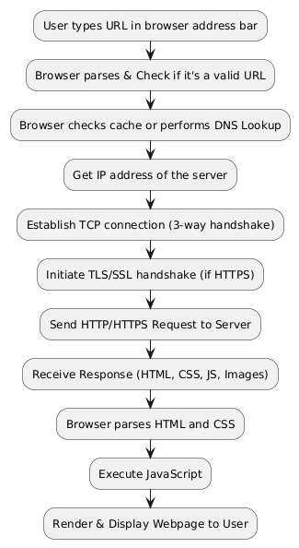
Representation of Flow

